Slide 1
Video Stream Programming
Computer Networks
Project 2

Slide 2
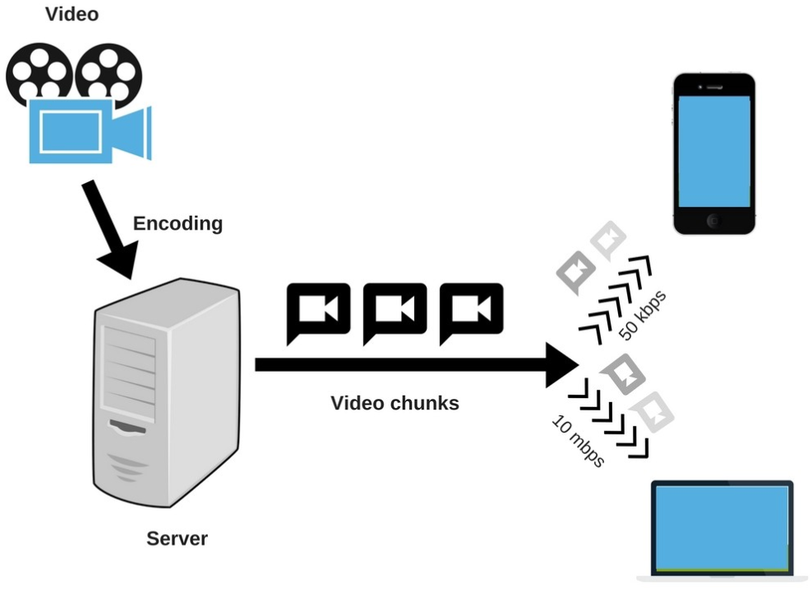
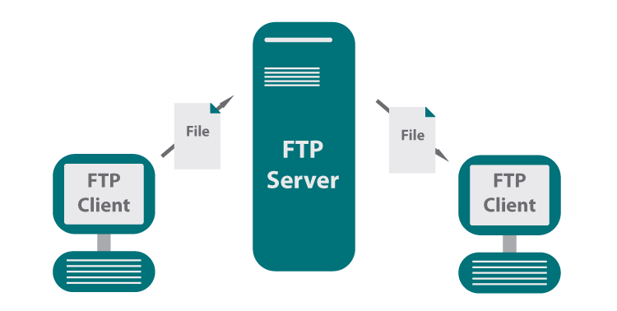
FTP vs. Streaming
FTP
Obtain the entire file for the content before watching or listening to it;
Streaming
Constantly receive and present multimedia file;

Slide 3
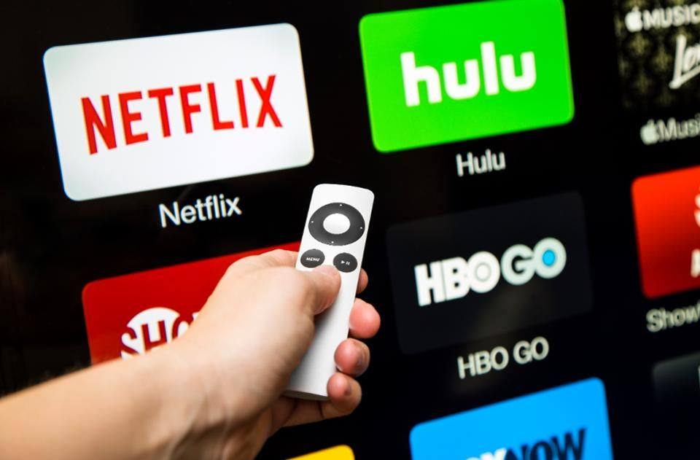
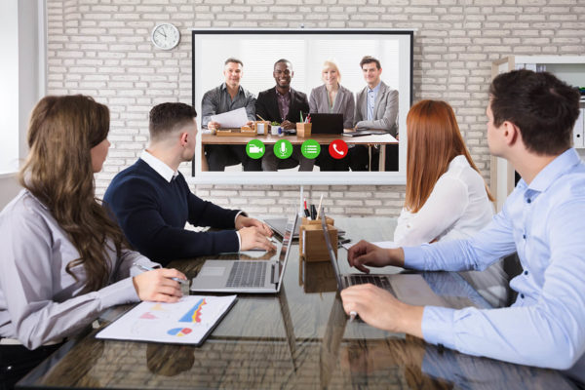

Video Streaming
HTTP streaming (TCP)
RTMP – Adobe
MMS – Microsoft
HLS – Apple
UDP streaming
RTP/RTC/RTSP

Slide 4
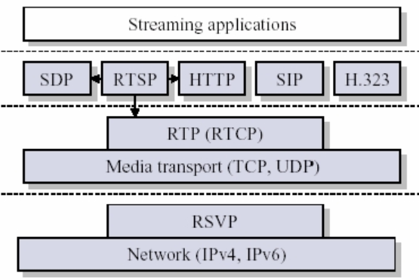
RTP/RTCP/RTSP Family
RTP: over transport layer, used for media data transmission;
RTCP: collocate with RTP, used for transmission state monitoring
RTSP: over RTP/RTCP, used for setup and control of the delivery of data with RTP

Slide 5
RTP
RTP header
Payload type: audio/video format indicator;
Sequence number: packet sequence;
Timestamp: sampling instance of the first byte in RTP packet;
SSRC: source of the RTP stream, distinct for each RTP stream;

Slide 6
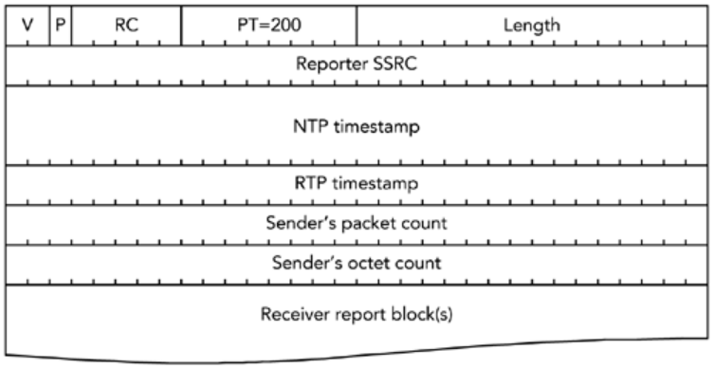
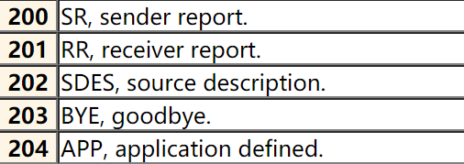
RTCP
RTCP header
PT: packet type.
RSSRC: Reporter’s stream identity;
NTP timestamp: sampling instance of the first byte in this packet
Packet count: number of packets sent;
Octet count: number of bytes sent;

Slide 7
RTSP
RTSP workflow
Setup TCP connection
OPTION: query supported commands
DESCRIBE: acquire media description
SETUP: setup RTP connection
PLAY: request for data transmission
PAUSE: pause streaming
TEARDOWN: close session

Slide 8
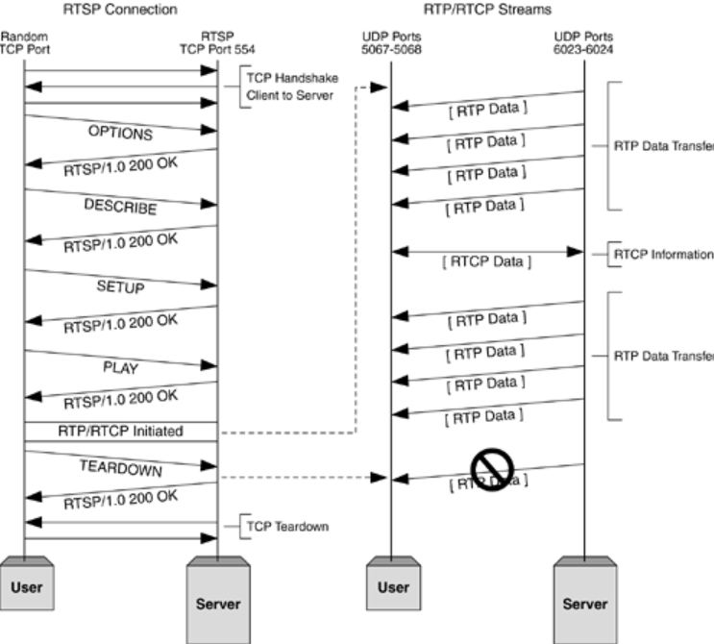
RTP/RTCP/RTSP Action Example

Slide 9
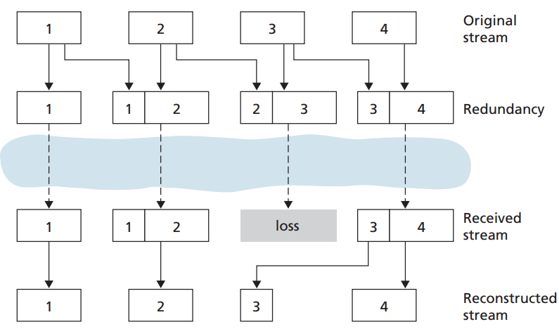
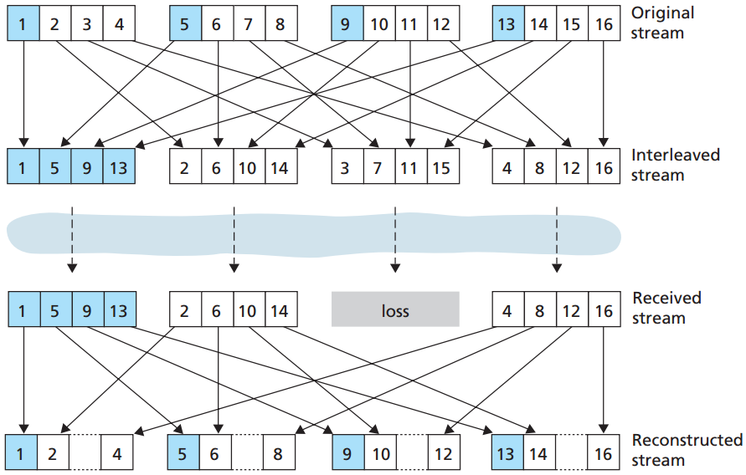
Problems with UDP Streaming
Packet loss
Forward Error Correction (FEC)
Interleaving

Slide 10
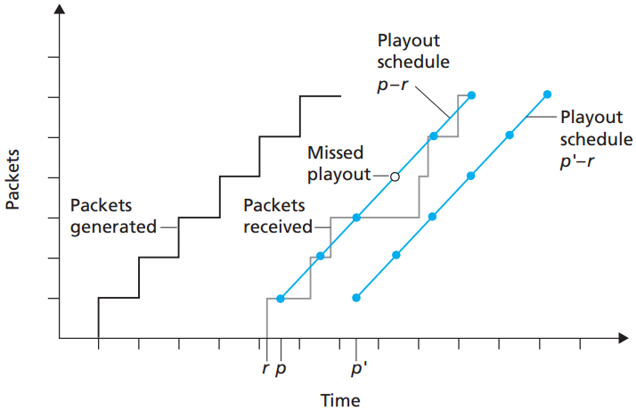
Problems with UDP Streaming
Jitter
Fixed playout delay
Adaptive playout delay

Slide 11
Project Description
Goal
To be familiar with video streaming services and its underlying RTP/RTCP/RTSP protocols.
Learn to implement video player on PC.
Learn to transmit streamed video between PCs.
Awaken your programming skills.

Slide 12
Task1: Pictures Streaming
Read the sample code
The sample code provides you with partially implemented RTSP and RTP protocol;
Modify the sample code
You will need to finish implementing RTSP and RTP in the client and server.
Your implementation should continuously transmit and display images from server to client.

Slide 13
Task2: Video Streaming
Choose your favorite language;
Must program with socket just like Project1;
MUST not use any libraries containing code specified designed to implement video streaming functionality;
Create RTP server and client from scratch that meets the compulsory demands:
Support SETUP/PLAY/PAUSE/TEARDOWN command in RTSP protocol and support RTP encapsulation.

Slide 14
Task2: Video Streaming
Support repositioning of play point.
Support change of play speed.
Support at least .mp4 file format (the more the b-etter).
Support streams from multiple clients on a single server.

Slide 15
Task2: Video Streaming
Adding some features will bring you higher grades, the optional features are as follows but not limited to:
Delay or advance audio track.
Support subtitle demonstration and adjustment.
Interactive subtitles;
Resume transmission after client reconnected.
Informative play list.
Search video by keyword or category on server.

Slide 16
Task2: Video Streaming
Optional features:
Video quality specification.
Switch to full screen.
Reliable transmission over UDP (use GBN/SR mechanisms).
Dynamic video encoding (H.264/MJPEG/...) under different network conditions.
Buffer mechanism for better users' experience.
Other features that are worth noticing.

Slide 17
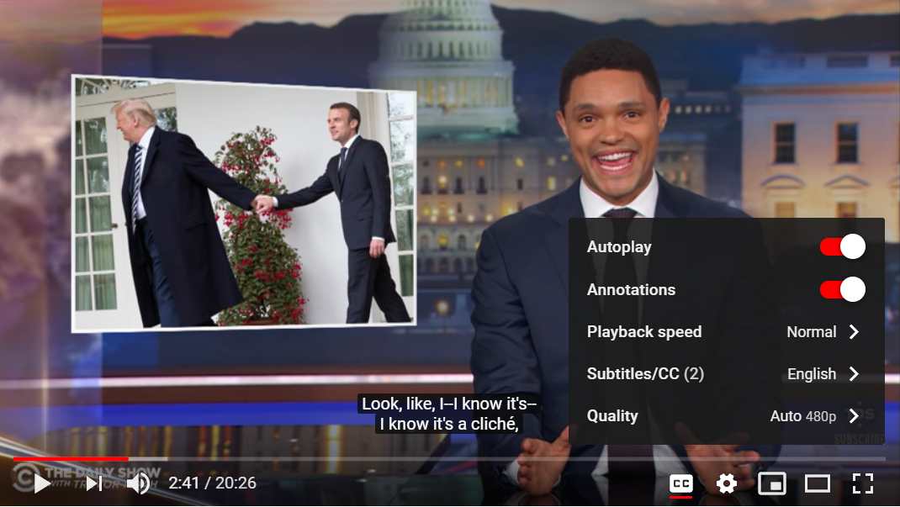
Examples

Slide 18
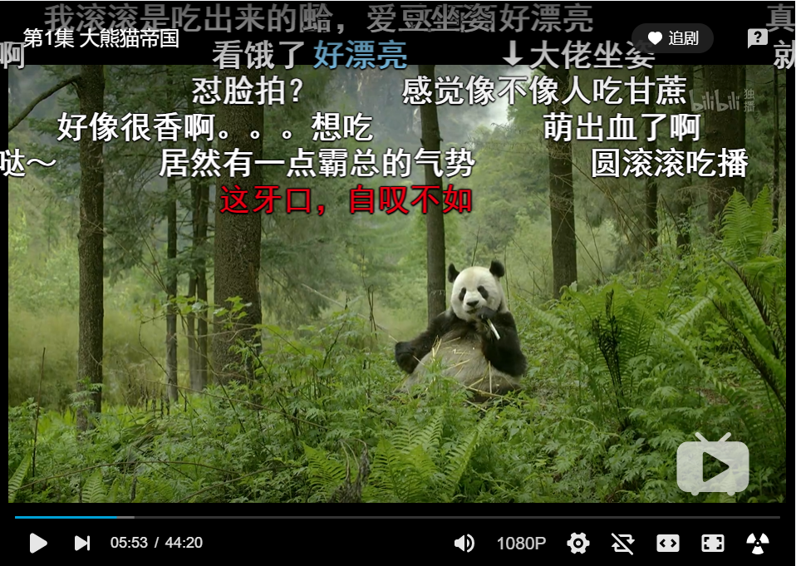
Examples

Slide 19
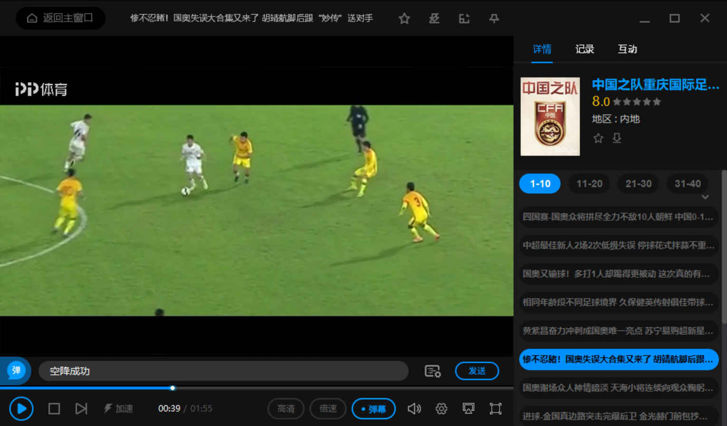
Examples

Slide 20
Some Important Issues
Grading
Task1 (20%)
Task2 (basic 40%+optional 20%)
RTP Server (20%+10%)
RTP Client (20%+10%)
Project Report (20%)

Slide 21
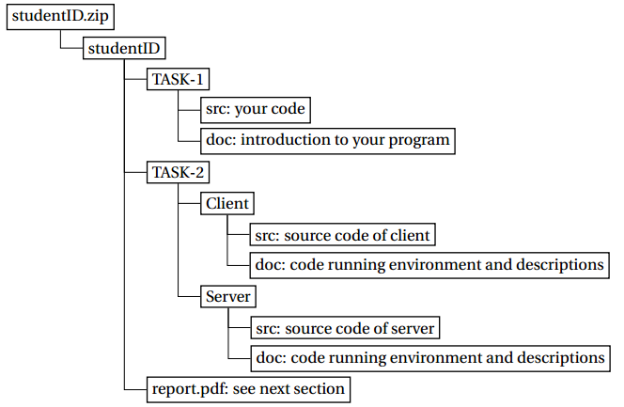
Some Important Issues
Submission
Source code and introduction to it;
Report: no longer than FIVE pages.
Files are to be organized as follows:

Slide 22
Some Important Issues
Important Date
Start up: today (2019.11.20.)
Due date:
3 weeks later (2019.12.11.)

Slide 23
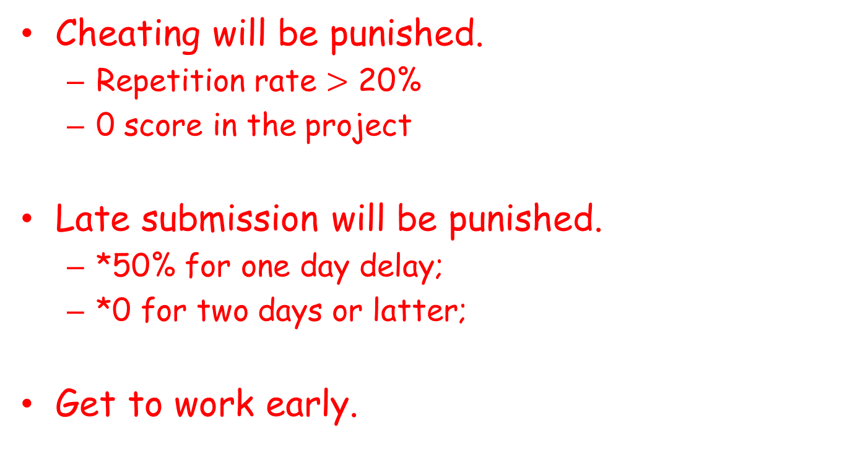
Some Important Issues
Cheating will be punished.
Repetition rate $>$ 20%
0 score in the project
Late submission will be punished.
*50% for one day delay;
*0 for two days or latter;
Get to work early.

Slide 24
Q&A

